Slide 1


My DSI Capstone
Sergio Insuasti
Project
Part II
Company Overview:
Sellable takes the hassle out of selling your home, they are property experts that buy homes, make them look spectacular, and sell it using the best agents in the business. Currently they are receiving requests for over 200 properties a month.
Data Details
Files were dropped into a Google Drive
Files contain Street, Suburb, Postcode, State, Latitude, Longitude
Clients Data is in PostgreSQL
File
NSW Data (Clean) 7.57 MB (7,940,482 bytes)
Type CSV
Total Records 88,528
Sample Data (Clean) 47.7 KB (48,905 bytes)
Type CSV
Total Records 546

Slide 2
Scope
Data:
Land size for each address may not be
Get correct Land size from
Satellite imagery
Google Maps if required
Clean Address information and
Link satellite Image Lot calculation
Create correlated plots and statistical graph representations of predictors
Show improvements to the Automated module after implementing machine learning

Slide 3
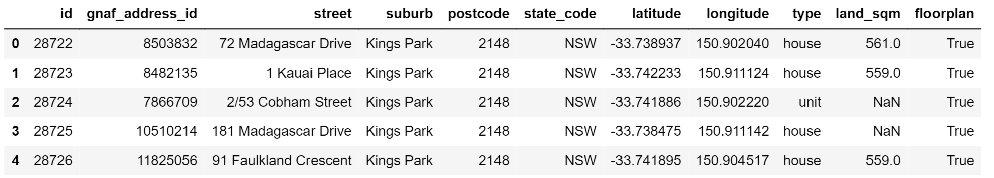
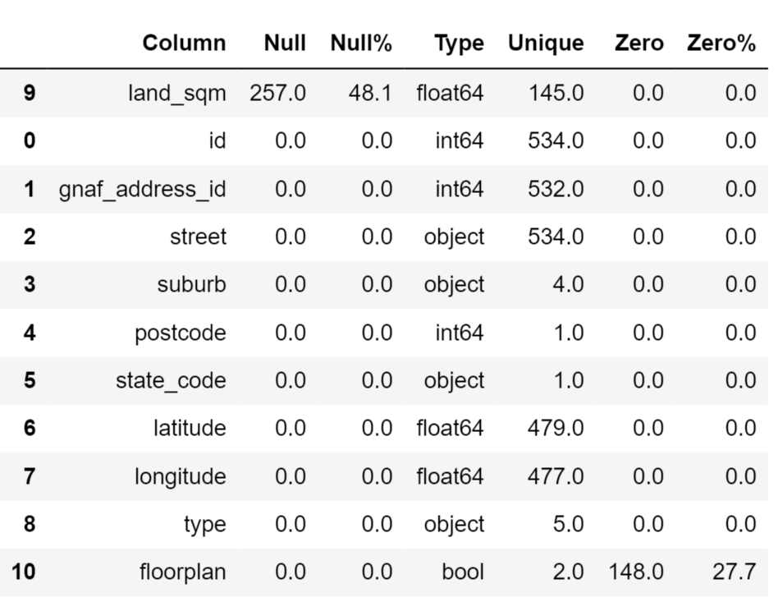
Investigate Client’s Data
Head()
Nulls & Zeros

Slide 4
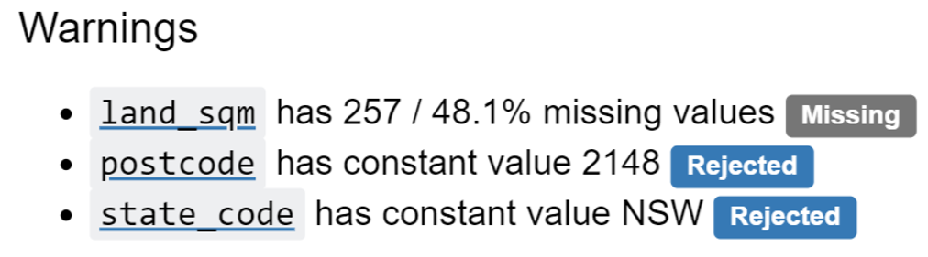
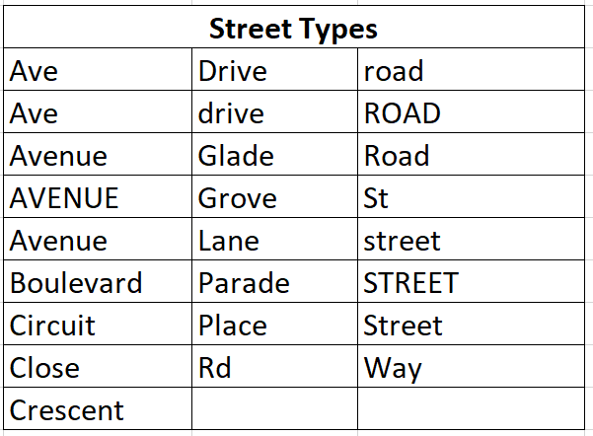
Investigate Client’s Data cont
Shape & Warnings
Shape (534, 11)
Lland_sqm 48% missing
Floorplan 27% missing
Street Cleaning Required

Slide 5
My File Details
Path C:\Users\sergi\Downloads\Sellable Scrapping\Datasets
Street_Abbreviations_on_file.csv
80 records
File contains
Abbreviation
List of combinations
Full Street Type
Modified_Sample_Data.csv
100 records
File contains
Id
Modified Address to access URL
Scrapped_data.csv
Expandable – Not known changes
File contains

Slide 6
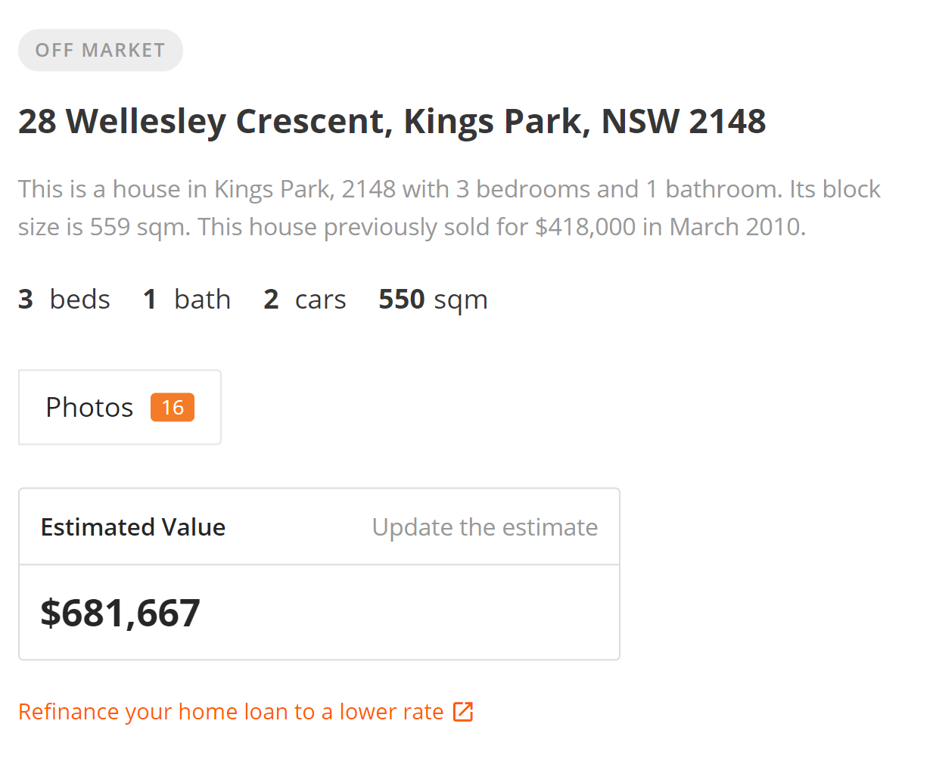
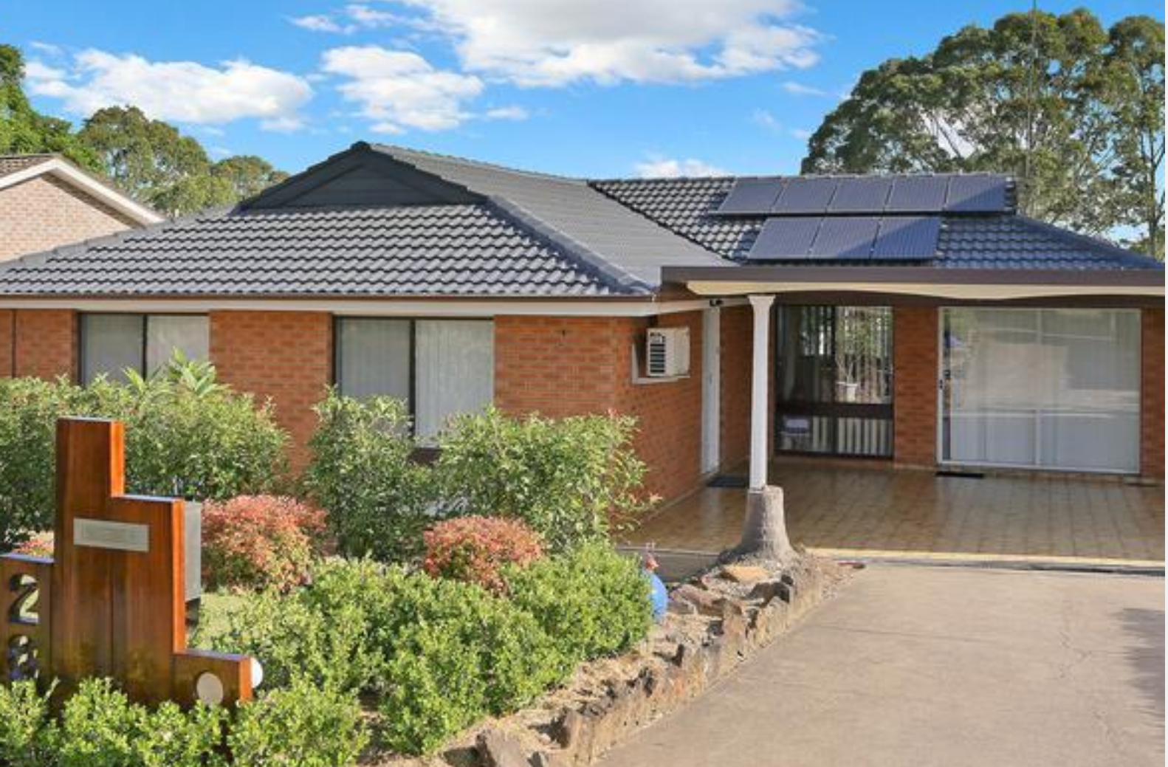
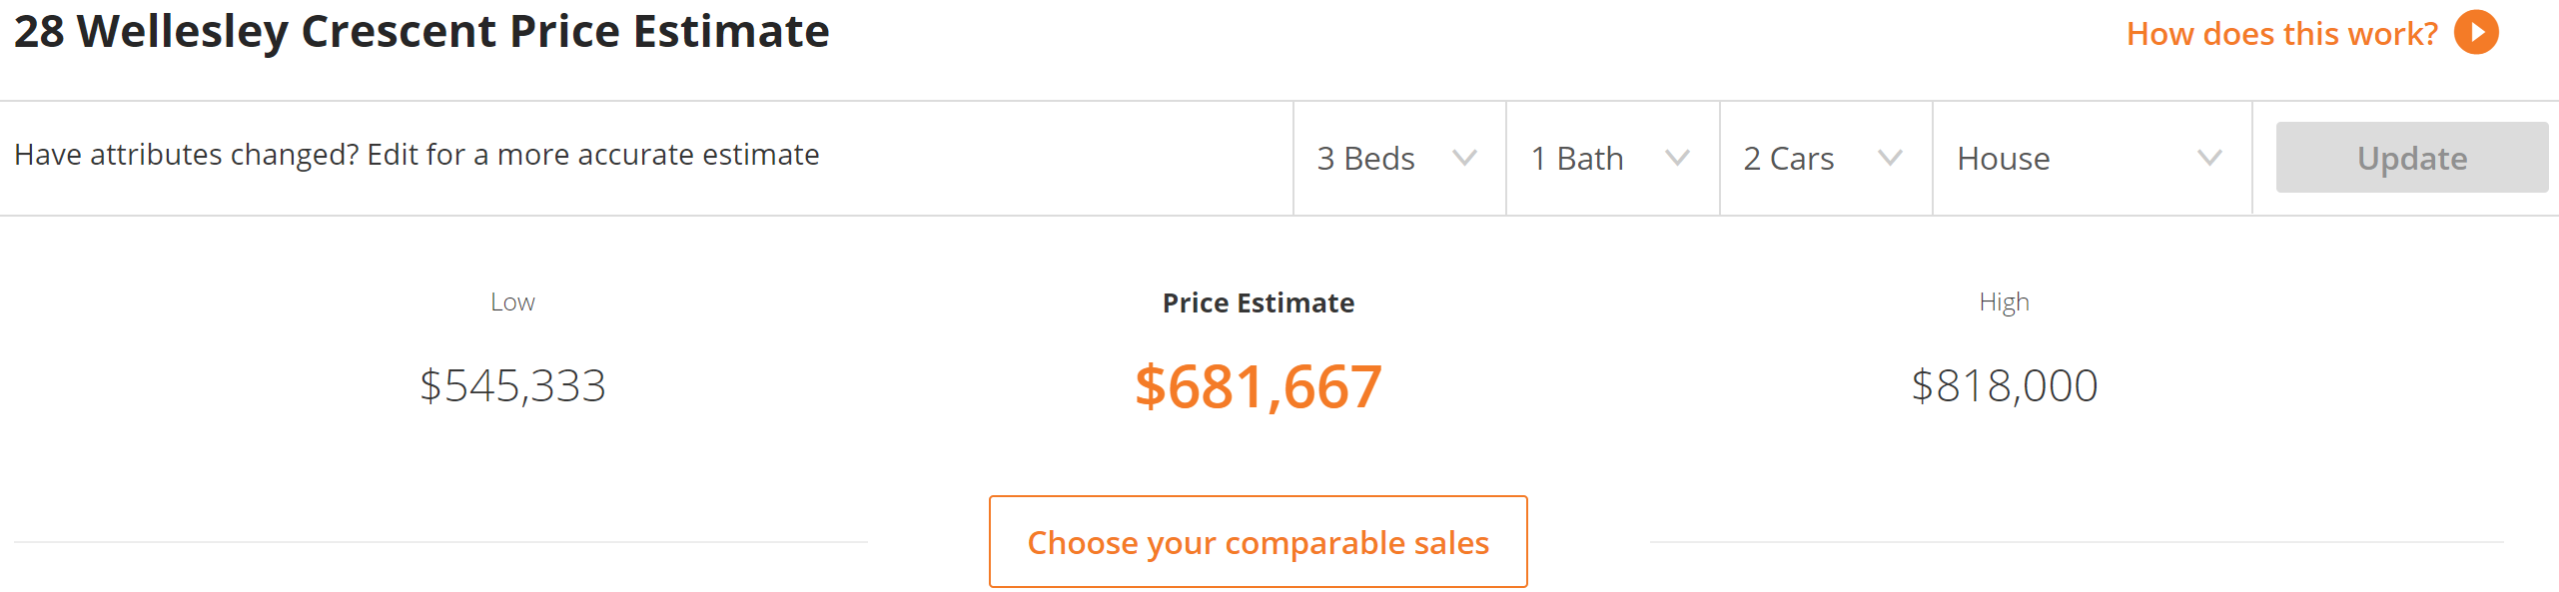
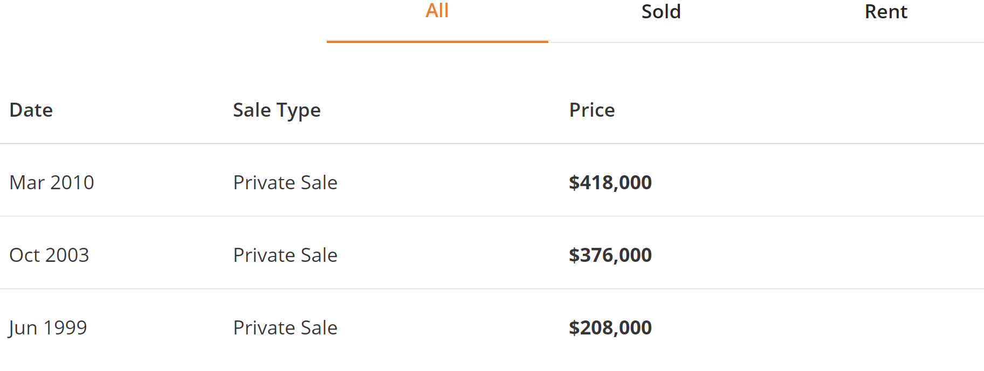

Slide 7
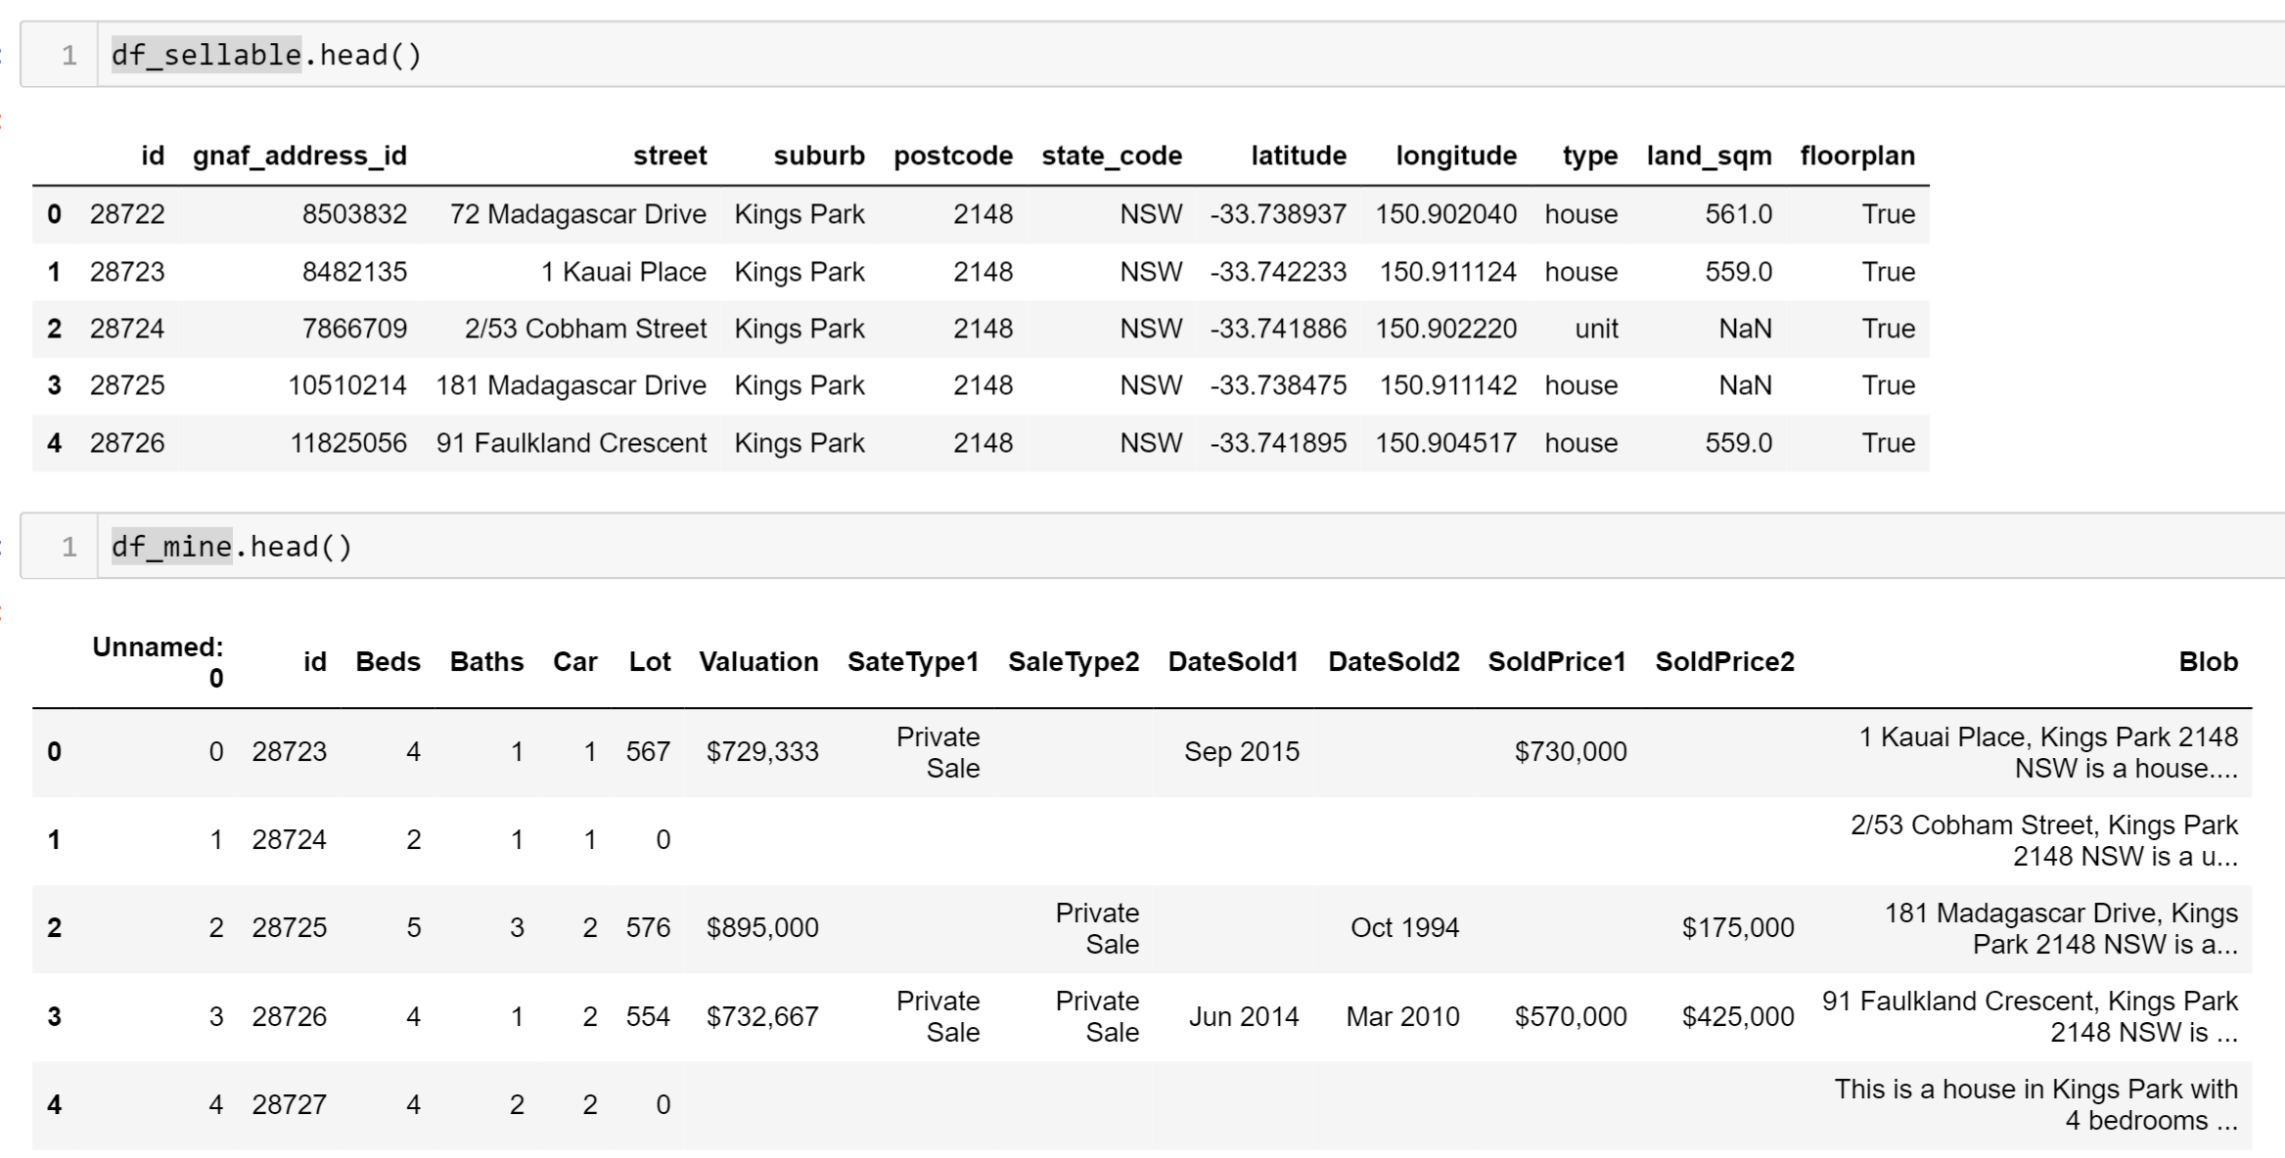
Scrapping Results

Slide 8
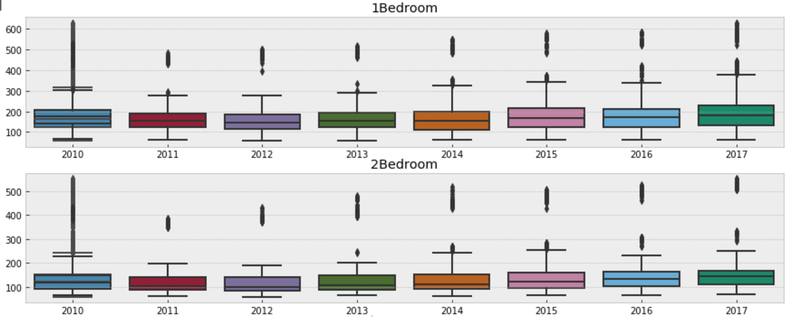
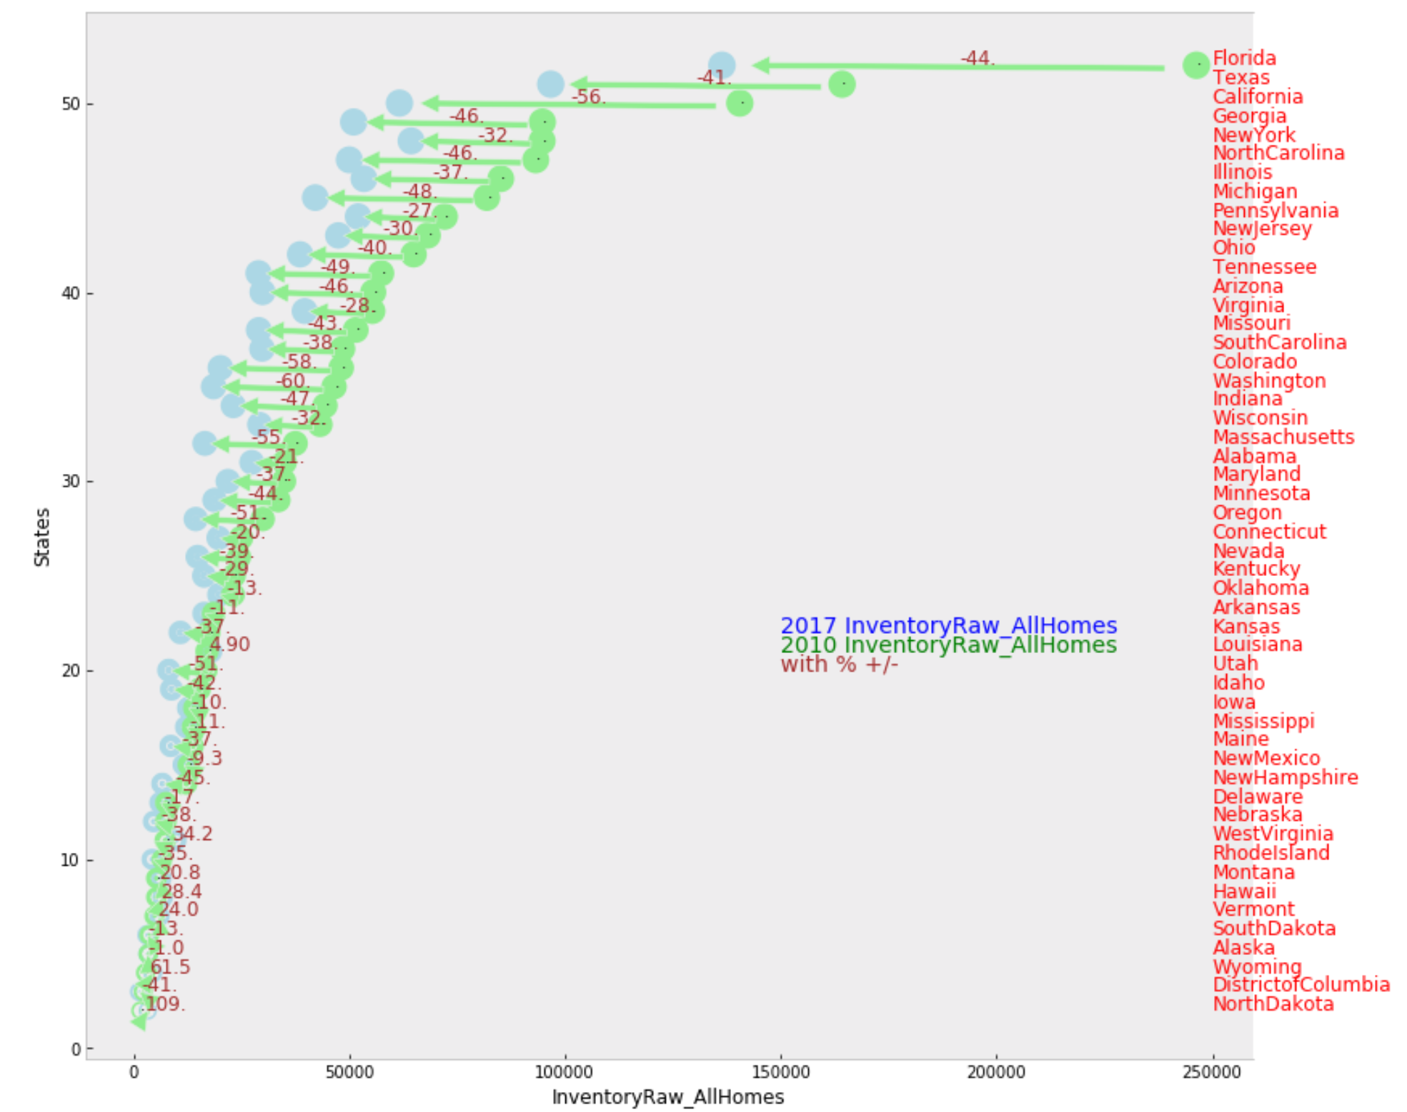
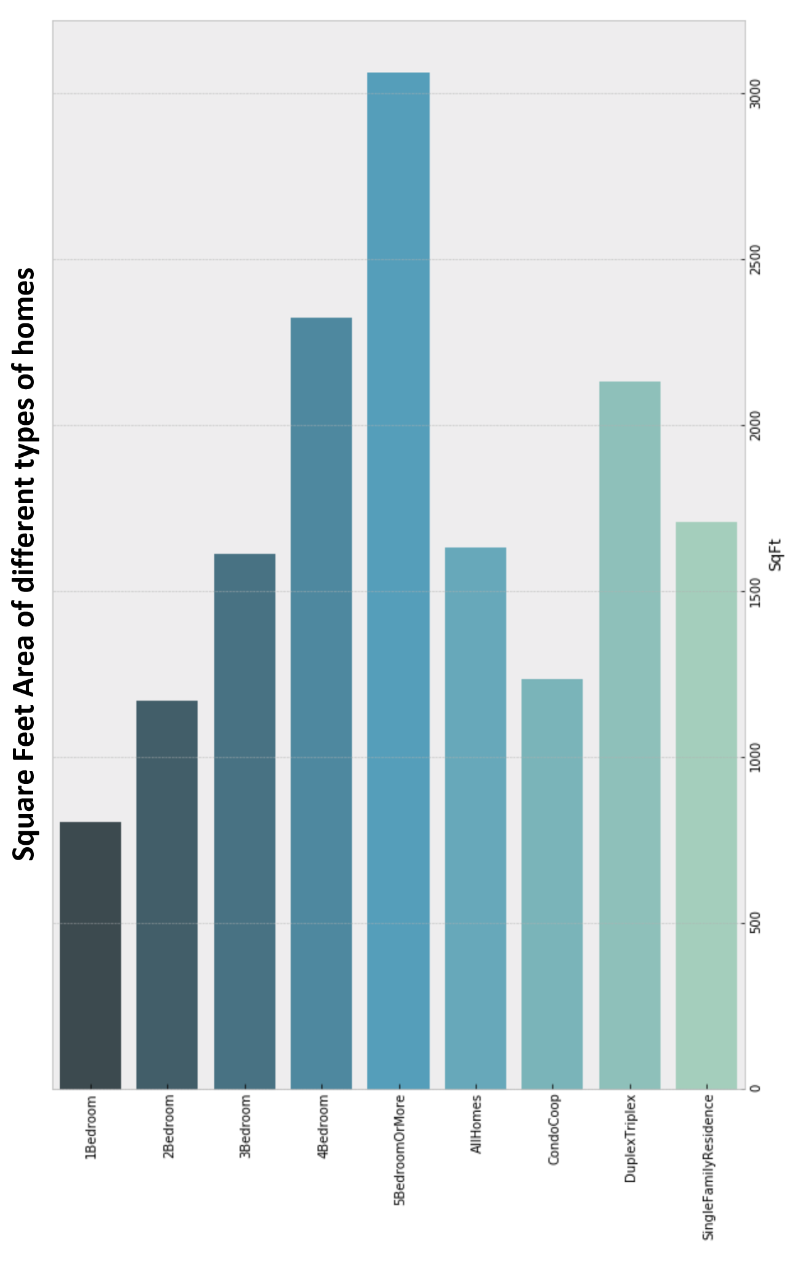
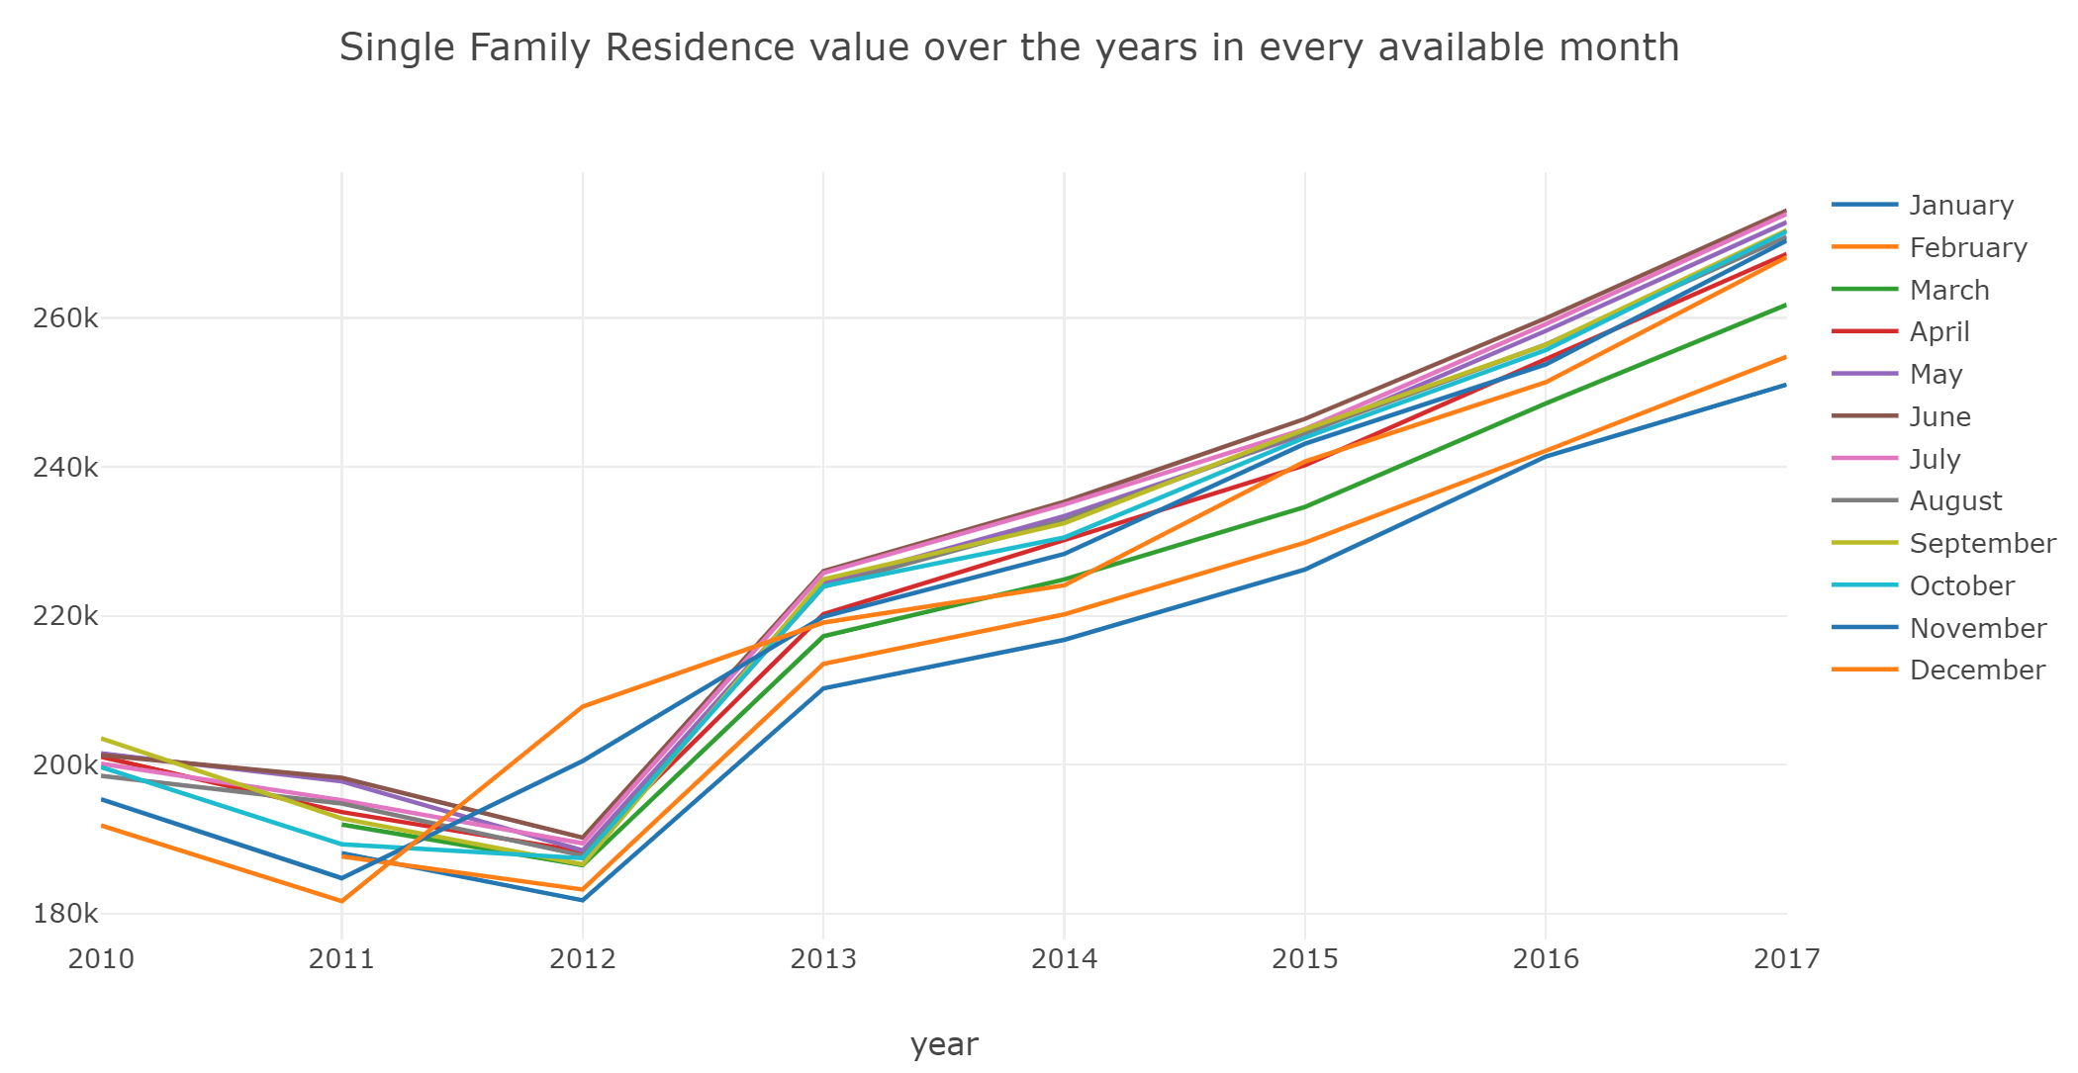
Yet To Do
Unsupervised
Image recognition to calculate lot size and construction size
Machine learn to calculate a predicted Valuation
Create statistical correlation graphs showing the price vs predictors.
Demonstrate using graphs the predictable algorithm model that would automate an estimated home price.

Slide 9
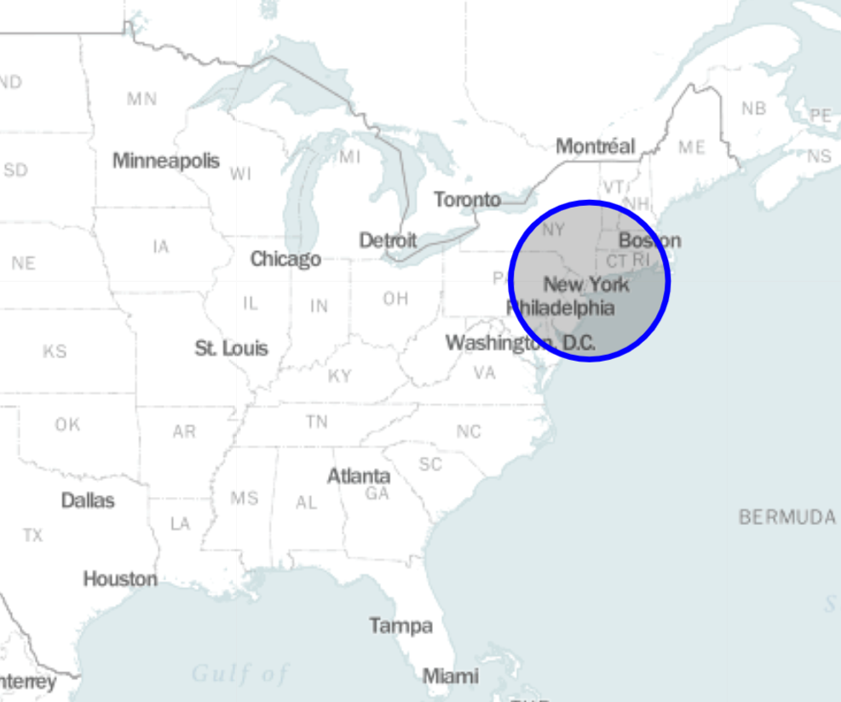
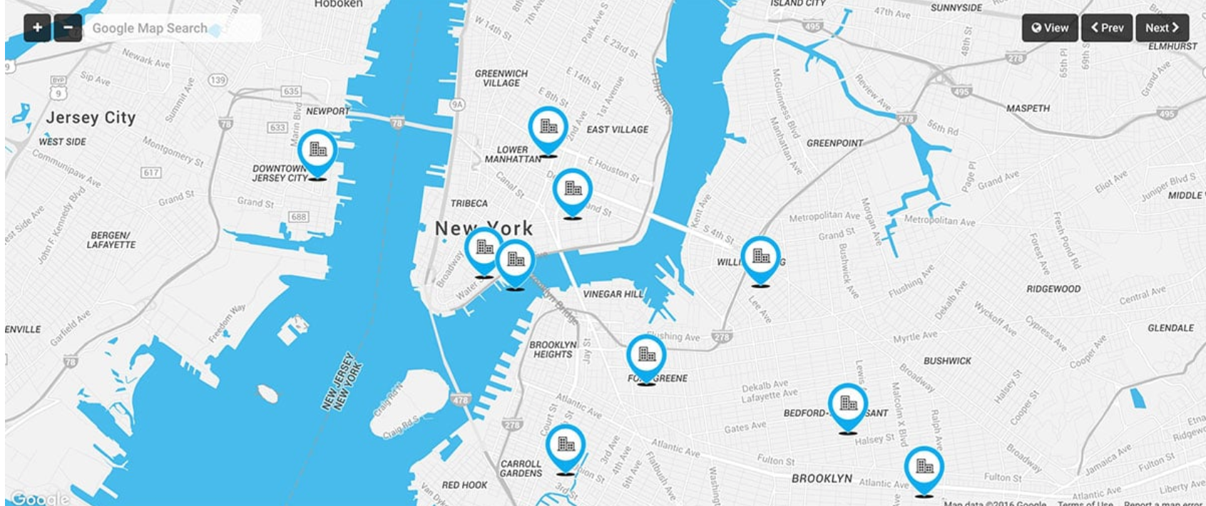
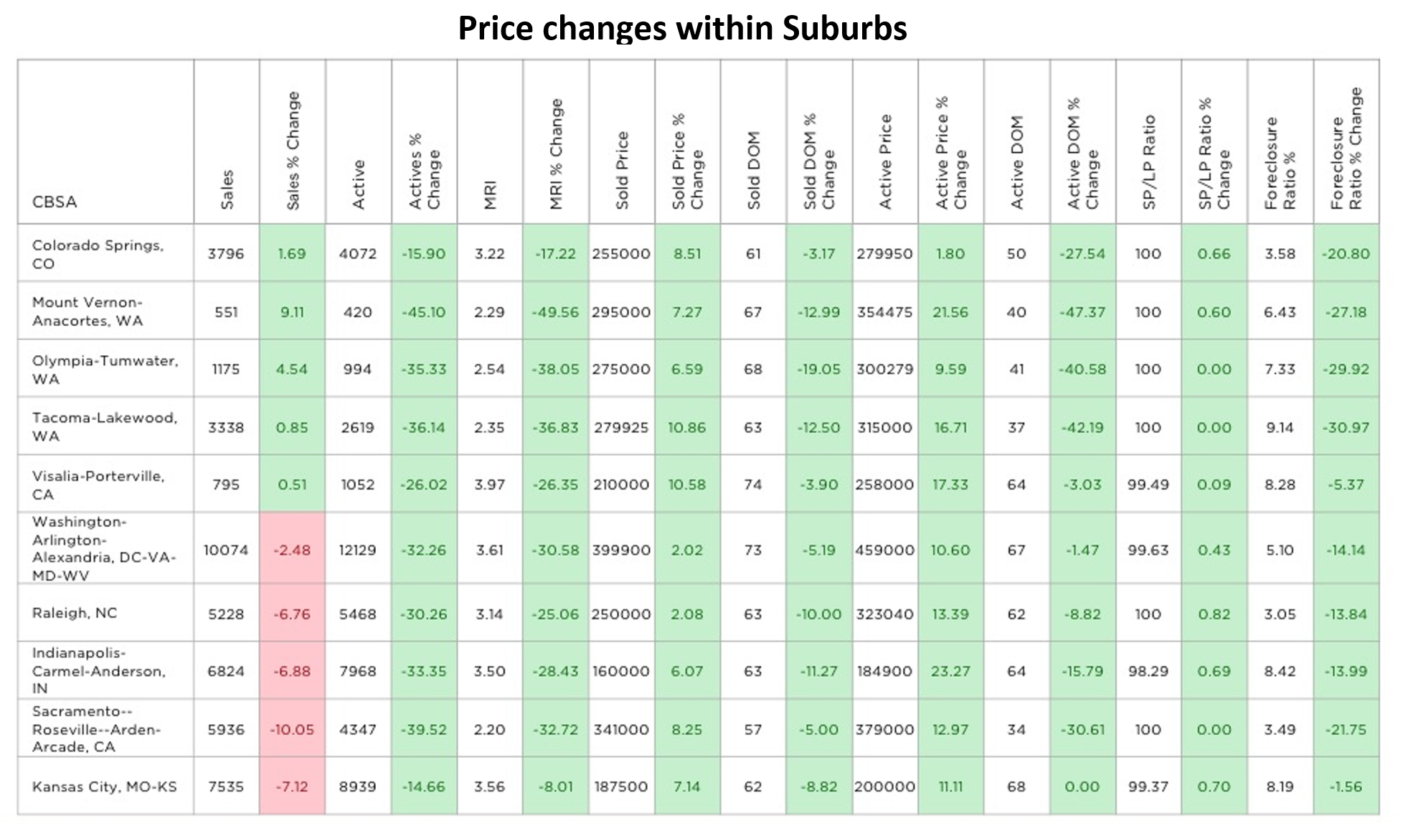
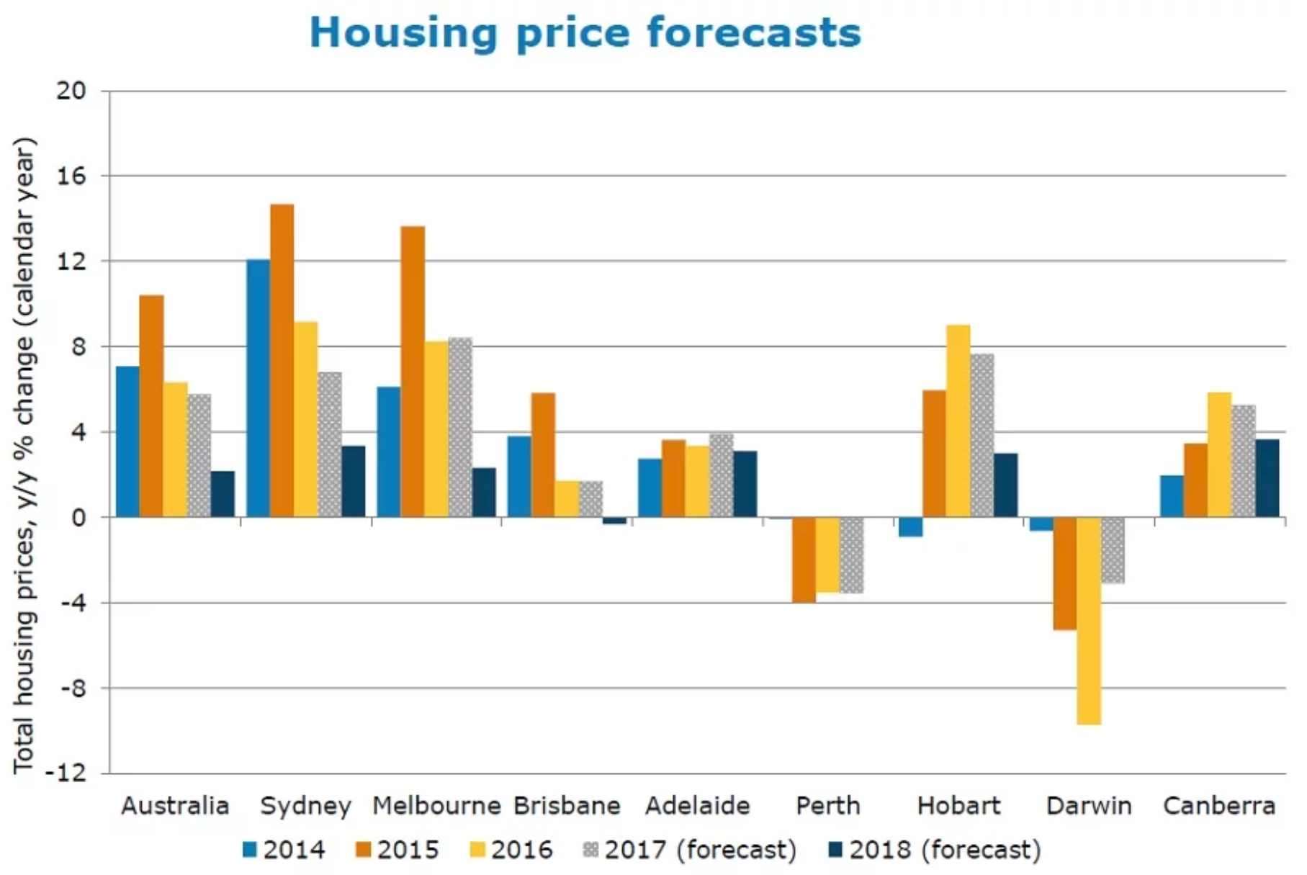
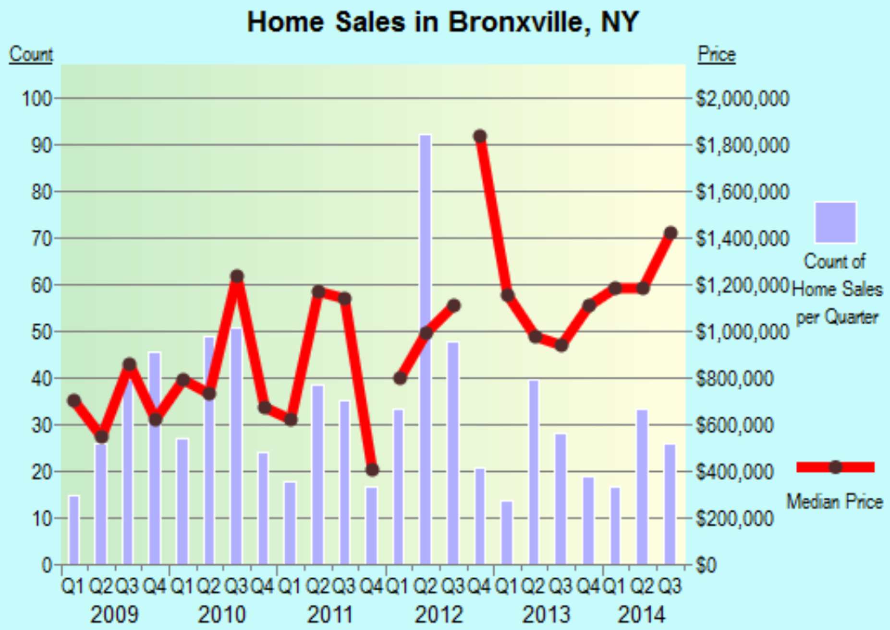
Mapping
Property location
Bar Plots
Histograms
Statistics

Slide 10
